Slide 1
彩虹 遊戲
cǎi hóng yóu xì

Slide 2
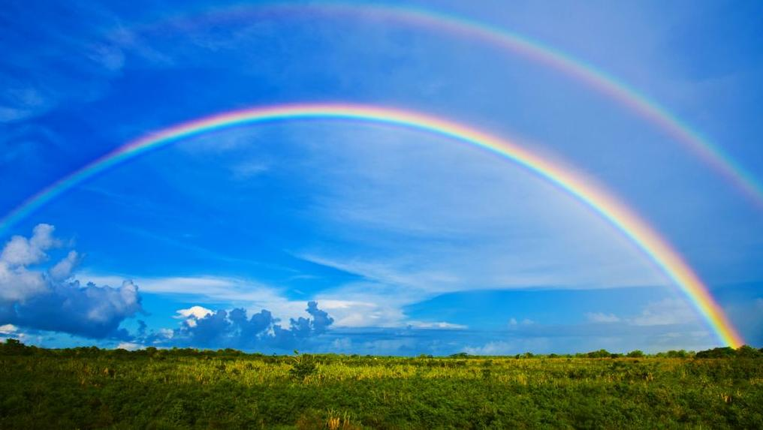
Notes:
在這個遊戲裏，你能“吃”彩虹

Slide 4
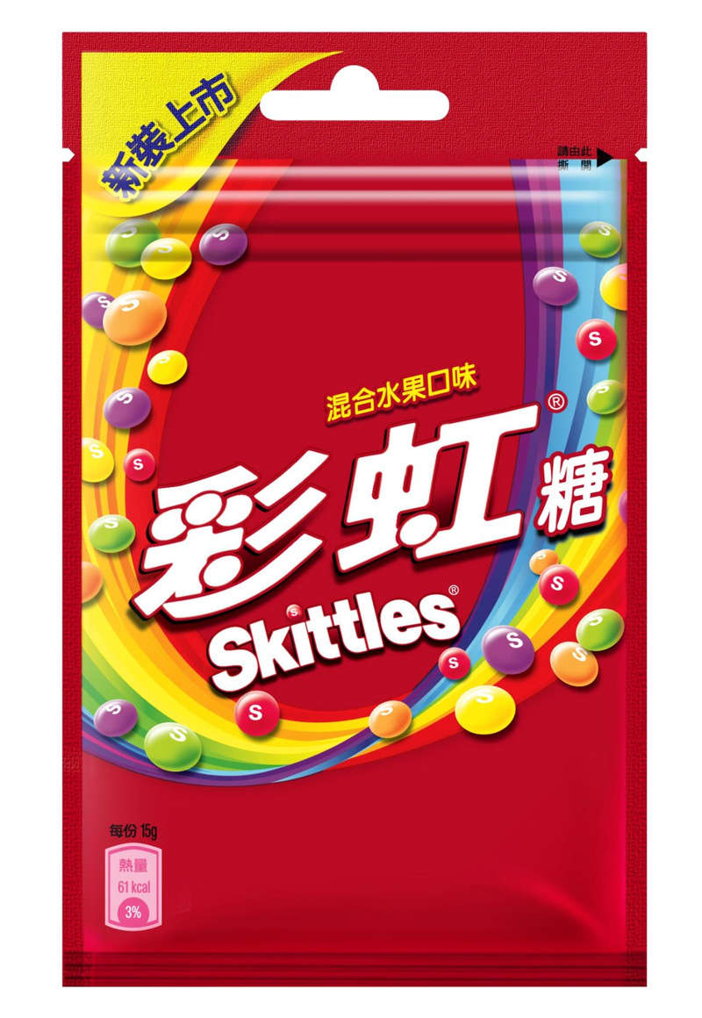

Slide 5
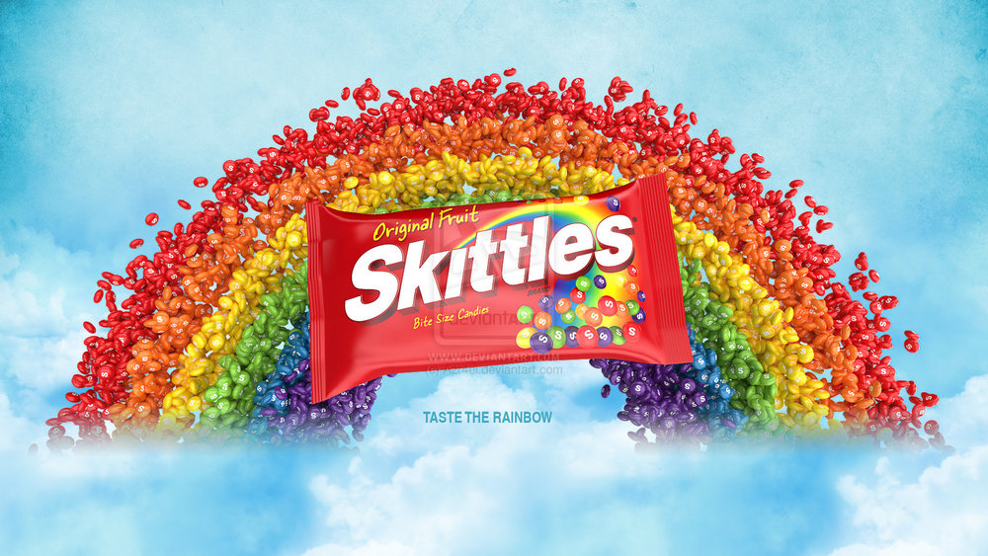
彩虹有什麼顔色？
紅色
橙色
黃色
綠色
藍色
紫色

Slide 6
Please speak in complete sentences: Wo xihuan…
Directions:
Each person in your group will take a turn grabbing a skittle from the cup and perform the task in the first column. All your answers must be in Chinese. Keep sharing around the circle. If you grab the same color, perform the task from the second column.

Slide 7
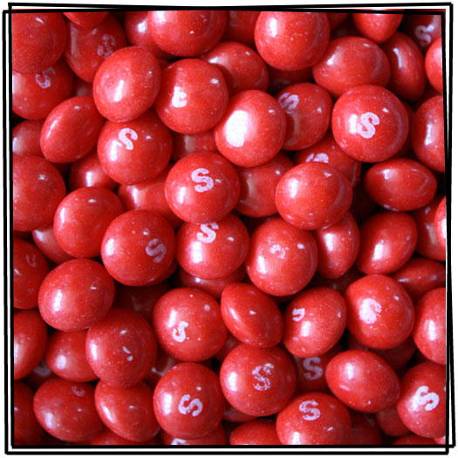
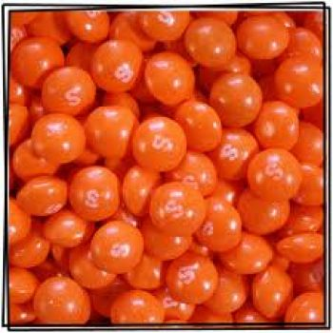
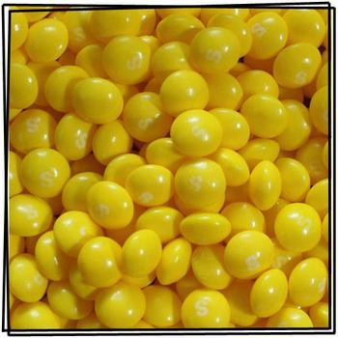
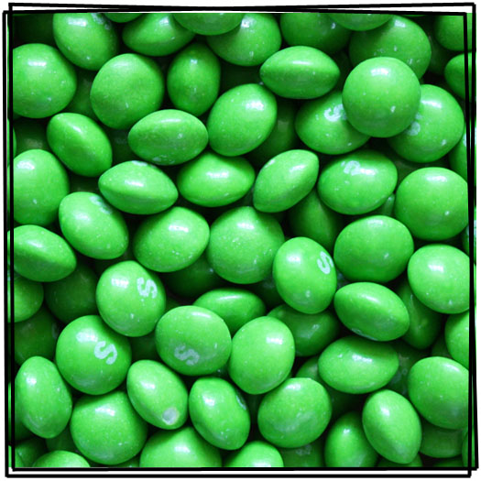
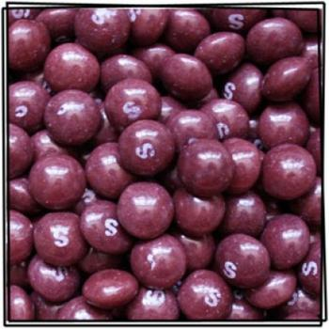
Your full name (L1)
How many people are in your family (L2)
Your age (L3)
Your nationality (L1)
Your birthday (L3)
What country’s food you like (L3)
Where you live
Your hobbies (L4)
What music you like to listen to
What you like to drink (L5)
What time you woke up this morning
What school you attend
Your favorite color (L9)
What you like to do on the weekends
Why you like Chinese

