Slide 1
覺得 & 有意思
Pull out a sheet of paper.
Write your name/class/these phrases:
Juédé: ___________
yǒu yìsì: ___________
méiyǒu yìsì: _________
As you read the following dialogue, figure out what these 3 phrases mean.

Slide 2
Person 1: Wǒ xiǎng kàn shū. Wǒ xǐhuān kàn shū. Nǐ ne? Nǐ juédé kàn shū yǒu yìsì ma?

Slide 3
Person 2: Wǒ juédé kàn shū méiyǒu yìsì.
Nǐ xǐhuān da qiú ma?

Slide 4
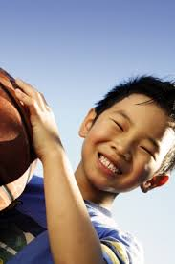
Person 1: Wǒ xǐhuān da qiú. Wǒ juédé dǎqiú hěn yǒu yìsì.

Slide 5
What do these phrases mean?
Juédé: ___________
yǒu yìsì: ___________
méiyǒu yìsì: _________

Slide 6
Write your own example using:
Juédé
yǒu yìsì
méiyǒu yìsì
Example:
Nǐ juédé kàn shū yǒu yìsì ma?
Wǒ juédé kàn shū méiyǒu yìsì.
* You can’t use kàn shū OR da qiú

