Slide 1
Hao + （好 ＋）
Using the Hao+ pattern, write a sentence for each of the following. There are several correct answers.

Slide 2
1. On your whiteboard, write a sentence to describe the following:
https://www.youtube.com/watch?v=Nk4UGwc5MnY

Slide 3
2. On the back of your yellow sheet, write a sentence to describe the following:
https://www.youtube.com/watch?v=HMGK61Jqq3c
Notes:
Kevin’s chili – The Office

Slide 4
3. On the back of your yellow sheet, write a sentence to describe the following:
http://giphy.com/gifs/hair-guy-day-mCZmQtzv8pU8o
Notes:
Bad beard day

Slide 5
4. On the back of your yellow sheet, write a sentence to describe the following:
https://www.youtube.com/watch?v=sOUsbtUrXHk
Notes:
Orchestra fail

Slide 6
5. On the back of your yellow sheet, write a sentence to describe the following:
http://giphy.com/gifs/mashable-3oEduMtNnQPlp0DF84
Notes:
Little kid hates food

Slide 7
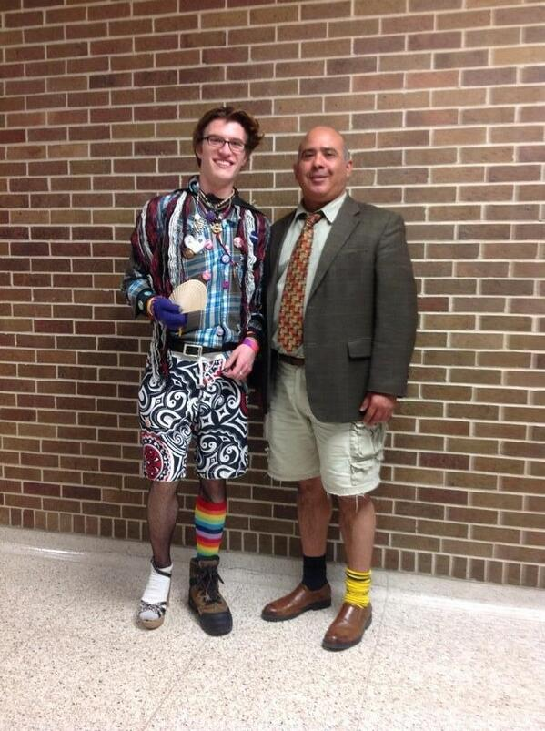
6. On your yellow sheet, write a sentence to describe the following:

Slide 8
7. On the back of your yellow sheet, write a sentence to describe the following:
https://giphy.com/gifs/seth-macfarlane-jj-abrams-qAfSEmVQMynoA

