Slide 1
Soft Drinks
Coke, Sprite, Fanta
Water
Hot water, ice water, boiled water,
Milk
Chocolate milk, Hot chocolate, Soy milk,
Tea
Green tea, Black tea, milk tea
Coffee
Juice
apple juice, mango juice, lemonade
Smoothies, Milkshakes

Slide 2
飲料 yínliào

Slide 3
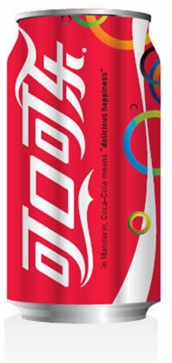
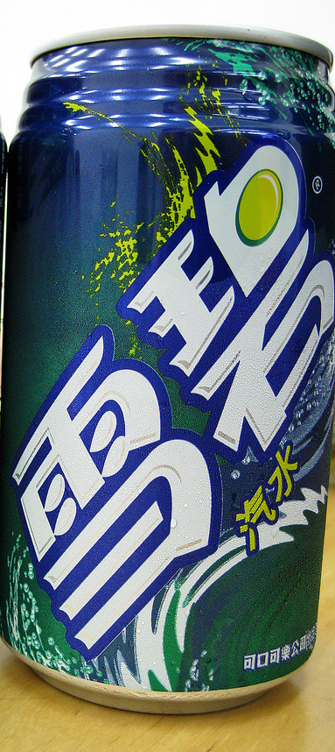
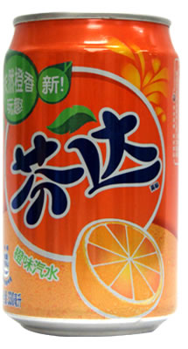
汽水
qì shuǐ
xuě bì
(kě kǒu)
kě lè
fēn dá

Slide 4
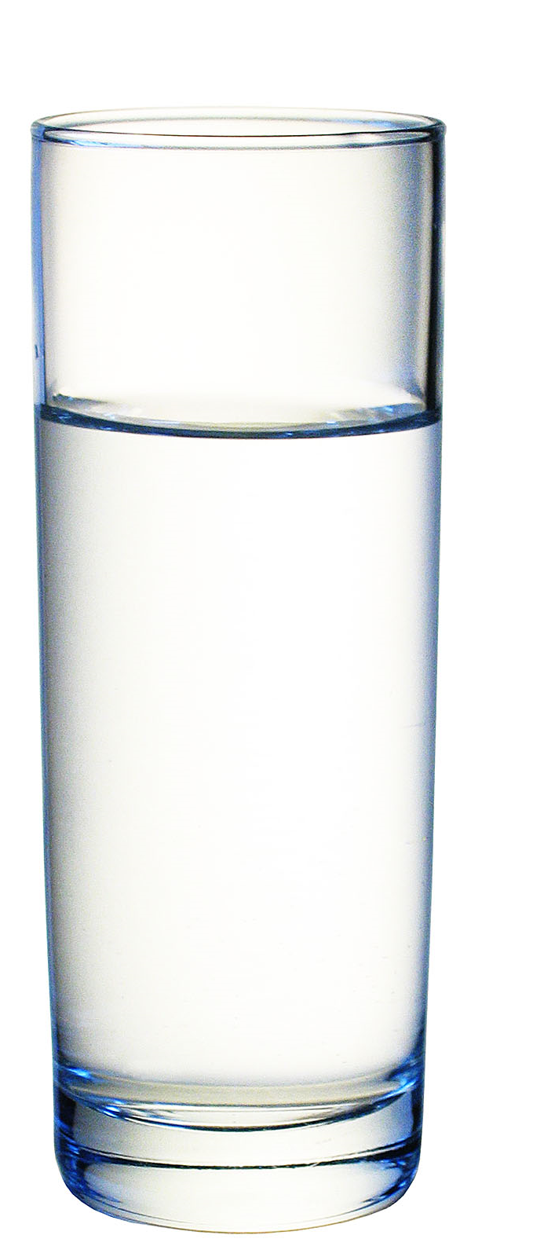
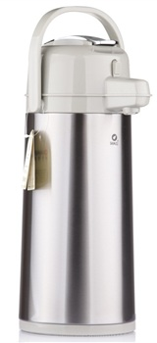
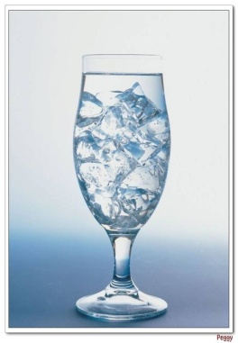
水
shuǐ
bǎi
kāi
shuǐ
rè
shuǐ
冰水
bīng shuǐ

Slide 5
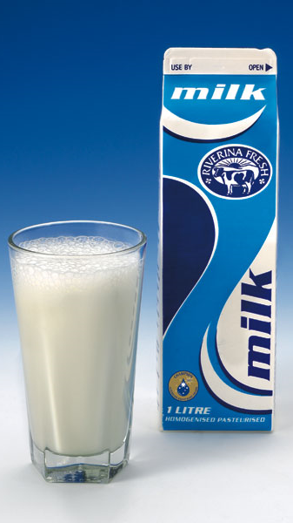
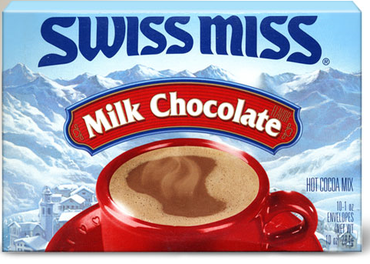
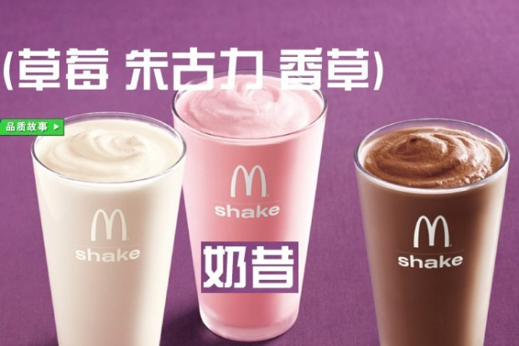
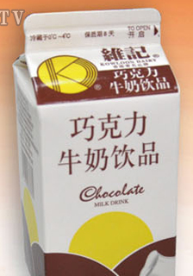
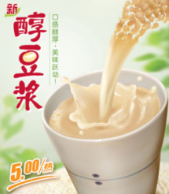
牛奶
niú nǎi
rè qiǎo kè lì
dòu jiāng
qiǎo kè lì niú nǎi

Slide 6
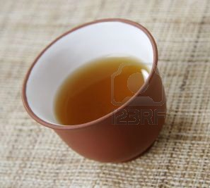
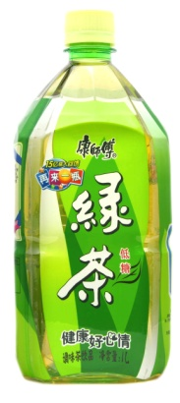
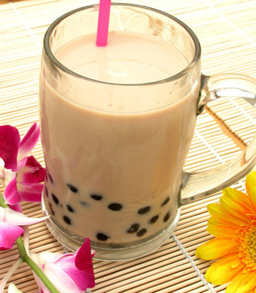
茶
chá
咖啡
kā fēi
hóng chá
nǎi chá
lǜ chá

Slide 7
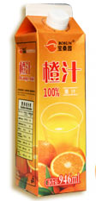
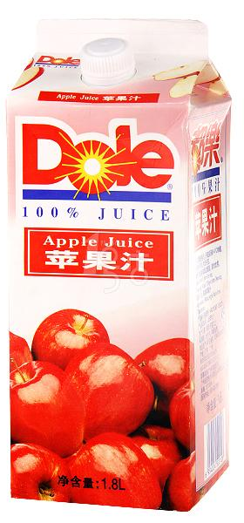
果汁
guǒ zhī

Slide 8
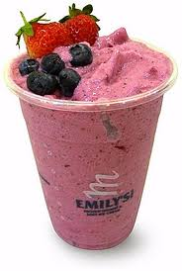
冰沙
bīng shā

Slide 9


Slide 11
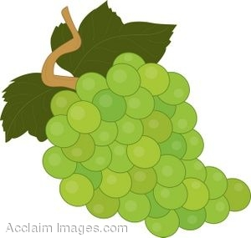

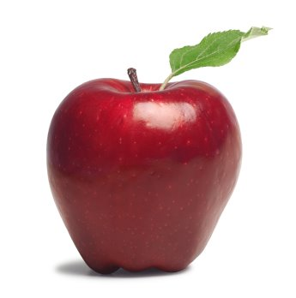
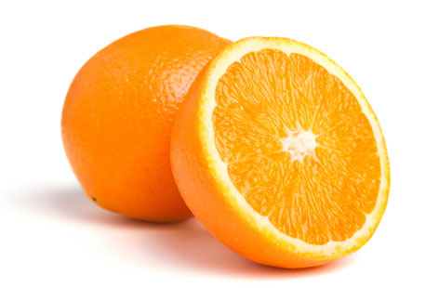
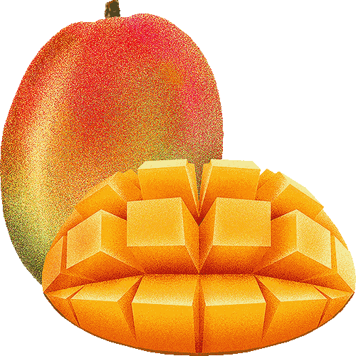
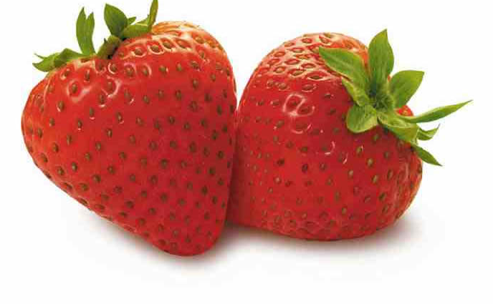

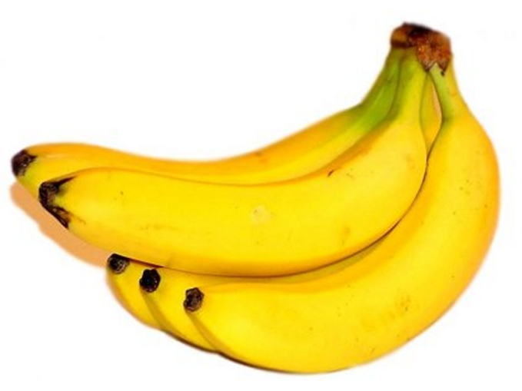
水(shuǐ)果(guǒ)

