Slide 1
How do you get from “pants” to “I want to buy a pair of black long pants”

Slide 2
pants
kùzi 褲子
long pants
chángkù 長褲 (shorts – duǎnkù 短褲)
black long pants
hēisè de chángkù 黑色的長褲
a pair of black long pants
yī tiáo hēisè de chángkù 一條黑色的長褲
measure words jiàn, tiáo, shuāng,
wear a pair of black long pants
chuān yī tiáo hēisè de chángkù 穿一條黑色的長褲
wear a pair of expensive black long pants
chuān yī tiáo hěn guì de hēisè de chángkù

Slide 3
I am wearing a pair of black long pants (present tense)
wǒ zài chuān yī tiáo hēisè de chángkù
Yesterday, I wore a pair of black long pants (past tense)
zuótiān, wǒ chuān le yī tiáo hēisè de chángkù
Tomorrow, I will wear a pair of black long pants (future tense)
míngtiān, wǒ huì chuān yī tiáo hēisè de chángkù
Tomorrow, I will buy a pair of black long pants
míngtiān, wǒ huì mǎi yī tiáo hēisè de chángkù
I want to buy a pair of black long pants.
wǒ yào/xiǎng mǎi yī tiáo hēisè de chángkù
I want to buy two pairs of black long pants.
wǒ yào mǎi liǎng tiáo hēisè de chángkù

Slide 4
describe what clothes you are wearing….
take a picture and do an educreation….
belvedere family stickers spot the difference
announce a quiz????
transition to shopping….
make a powerpoint for grammar for this chapter….
what’s in your closet…..

Slide 5
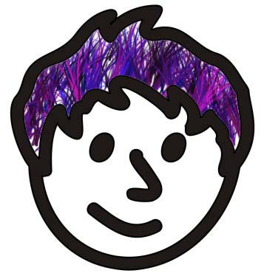

Slide 6
Dialogue 1
do a paper where they have to write down the meaning of each word…
買
商店
衣服店
號
貴
便宜
顔色
長短
大小
合適
試一下
多少錢
塊
毛
分
一共
找

Slide 7
買/賣
多少錢？
貴/便宜

