Slide 1
Clothing

Slide 2
Chuān vs dài
Chuān: below head
Dài: hands above head

Slide 3
Pull out your clothing vocab sheet
On your sheet of paper, write a sentence describing what the person is wearing using either chuan or dai.
I’ll show you 2 examples.

Slide 4
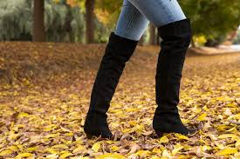
Tā chuān xuēzi.

Slide 5
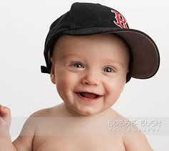
Tā dài bàngqiú mào.

Slide 6
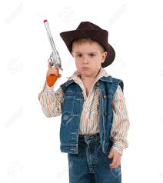
1.

Slide 7
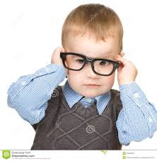
2.

Slide 8
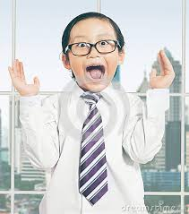
3.

Slide 9
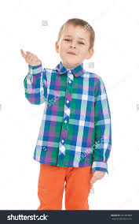
4.

Slide 10
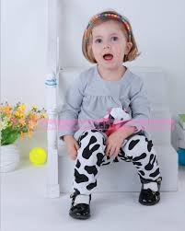
5.

Slide 11
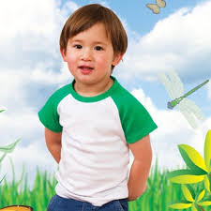
6.

Slide 12
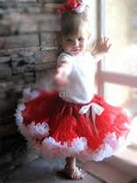
7.

Slide 13
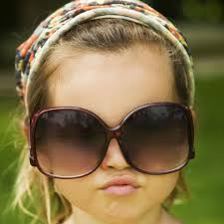
8.

Slide 14
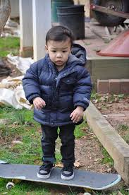
9.

Slide 15
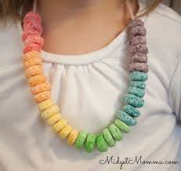
10.

Slide 16
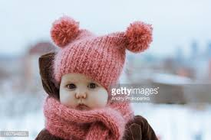
11.

Slide 17
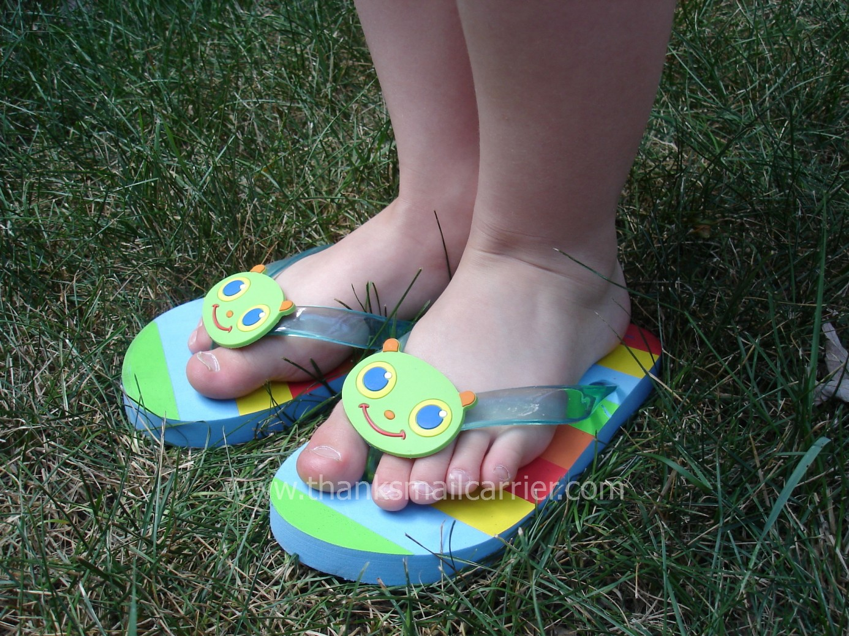
12.

Slide 18
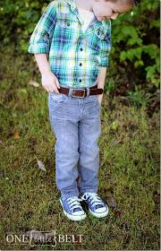

Slide 20
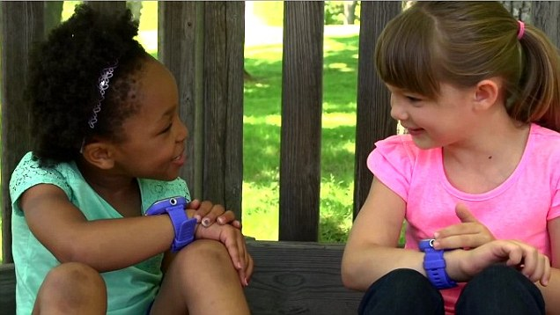

Slide 21
